Slide 1
IS3S687 CW1M: Internet of Things (IoT) Design Case Study using the Raspberry Pi
Dr Paul Jarvis
paul.jarvis@southwales.ac.uk

Slide 2
Assessment
2 courseworks:
Write a written report, create an implementation, perform demonstration in class
CW1 | Fri 1/11/24 | 50%
CW2 | Fri 13/12/2024 | 50%

Slide 3
Coursework 1
Full details available on Blackboard
You are required to create a case study of an Internet of Things (IoT) system. The case study must contain two deliverables:
A written report in which you must present a scenario which may benefit from an IoT solution, using the Raspberry Pi and associated external sensors via the GPIO. You must describe the context of your scenario and propose your solution.
A prototype of your system based entirely on the sensors included in the CrowPi kits. You must submit your Python code and provide a demonstration of your working prototype.

Slide 4
1. The Written Report
1000 words in length (20% either side)
Must include the following sections:
Introduction: An introduction to your document that concisely sets out the topic of your case study and the aims and content of the rest of your report.
Scenario: An explanation of your scenario and the nature of the challenges that exist in your chosen context. You should then outline your proposed IoT solution and highlight the benefits it will bring to your chosen scenario. Identify the types of sensors and output devices that would be required and the role that they would play as part of your system. Note that these devices do not necessarily need to feature on the CrowPi, here you should be discussing a full-scale version of your solution.
Visual Representation: A visual layout or schematic diagram to show where IoT equipment would be placed in a full-scale version of your system.
User Interface: An explanation of a suitable IoT User Interface for a smartphone or other device that will allow your system to be monitored and/or controlled. You should include a mock-up screenshot of your interface.
Images can be created using a suitable graphics package or hand-drawn.

Slide 5
2. The Prototype
Your prototype system must be implemented entirely using a CrowPi kit as used in class. It should make use of the CrowPi sensors and/or outputs to replicate the system proposed in your written report, on a smaller scale.
The implementation must make use of at least three sensors and/or output devices that will operate in a complementary way to produce a useful system.
As a prototype, the system you create does not necessarily need to include all features of your proposed IoT solution as described in the written report.
For example, your proposed system might entail use of an output device that is not included in the CrowPi, so you might substitute this with a text output to the CrowPi display. Or the proposed system might require multiple sensors, some of which are unavailable, so an alternative sensor could be used, or the sensor could be left out of your prototype system (assuming other sensors are implemented).

Slide 6
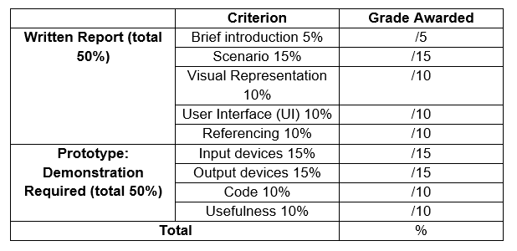
Marking Criteria

Slide 7
Hints
Do not feel constrained by the features on the CrowPi when proposing your solution. Your written report might refer to sensors or outputs that are not available on the CrowPi, but can be substituted or left out of your prototype implementation.
However, you should choose a scenario and solution that allows you to demonstrate your skill at using the CrowPi, so think carefully about which sensors are available and would allow you to create a viable prototype.

Slide 8
CrowPi devices
Look at the CrowPi Lessons pdf document for guidance on these:
Sound sensor
DH11 sensor
Motion sensor
Vibration sensor
Light sensor
Ultrasonic sensor (distance detector)
LCD display
7 Segment display
Touch sensor
Tilt sensor
Button matrix
It will be a bit much to learn all of these if you are not going to use them.
Look at the descriptions and think about what you could use them for

